Slide 1
Exploring and Visualizing Trends in News Data
max growth
AIT 684
Nikitha Budipati
Sophia Herman

Slide 2
Sophia
Nikitha
Dataset Preparation & Visualization
Research

Slide 3
The Problem
Frequency
Co-Occurrence
Sentiment
Which entities appear most frequently over time, and in which categories?
Line Charts, Stacked Bar Graphs, Scatter Plots
What relationships exist between co-occurring entities in news articles?
Heat Maps, Network Plots, and Frequency
How has the sentiment around key entities shifted over time?
2012 - 2022
Typically seen as “positive”, “negative”, or “neutral”
Verbs, Adjectives, Frequency, and Co-Occurrence

Slide 4
Why value seeing news trends?
Shifts in public discourse can inform the media landscape, assisting journalists, politicians, educators, etc. in identifying public dynamics:
Opinions, in reception to the news, may influence news coverage and journalism.
Tracking sentiment around policy changes can be used to gauge public reception.
Can identify networks of misleading information and their potential impact.

Slide 5
The Dataset
210k headlines from 2012-2022
Fewer headlines post-2018
Columns:
Headline
Category
Authors
Publication Date
Short Description
Source Link
Huffington Post
2012 - 2022

Slide 6
Data Collection and Preprocessing
Extracted from Huffington Post using:
BeautifulSoup API
Selenium
Chrome Driver
Removed all categories with less than 100 articles.
No additional preprocessing steps were taken to clean the data.
Misra, Rishabh. "News Category Dataset." arXiv preprint arXiv:2209.11429 (2022) https://arxiv.org/pdf/2209.11429

Slide 7
Background
The dataset was made available as part of open-source research and shared for academic and experimental purposes.
Hosted on platforms like Kaggle and GitHub for community use.
The intent is to encourage other researchers to study:
News categorization and classification.
Language modeling using real-world news data.
Pattern and trend analysis in digital journalism.
Training and testing machine learning and NLP models.
Misra, Rishabh. "News Category Dataset." arXiv preprint arXiv:2209.11429 (2022) https://arxiv.org/pdf/2209.11429

Slide 8
Other Papers Referencing This Dataset
Original Creator
Rishabh Misra
Introduced the dataset, with over 200k articles from the Huffington Post.
Provides guidance on collecting, preprocessing, and engineering data for ML.
https://arxiv.org/abs/2209.11429
https://rishabhmisra.github.io/Sculpting_Data_for_ML.pdf
https://github.com/rishabhmisra/News-Category-Dataset
Related
Matthias Hoffmann, et. al.
Highlights how datasets like the Huffington Post 2012-2022 dataset are used for analyzing media trends, biases, and reliability.
https://www.tandfonline.com/doi/full/10.1080/19312458.2022.2128099

Slide 9
Other Papers Referencing This Dataset (Pt 2)
Subject Categorization
Yueh-Huan (Kevin) Ho
A DistilBERT model trained to classify news articles into categories based on their headlines and descriptions.
https://huggingface.co/Yueh-Huan/news-category-classification-distilbert
Rafid Abyaad, Md Rayhan Kabir, S. Hasan
Presents deep learning for categorizing news articles using headlines and descriptions.
https://www.researchgate.net/publication/345506060_A_Novel_Approach_to_Categorize_News_Articles_From_Headlines_and_Short_Text
Nafiza Tabassoum, Md. Ali Akber
Implements Explainable Artificial Intelligence techniques to interpret machine learning models applied to news category classification.
https://www.researchgate.net/publication/380837270_Interpretability_of_Machine_Learning_Algorithms_for_News_Category_Classification_Using_XAI

Slide 10
Other Papers Referencing This Dataset (Pt 3)
Trend Identification
Sotomsa on GitHub
Extracted trends and patterns in news content, categories, and authors.
https://github.com/sotomsa/HuffPostDataSet
Jiachen Sun, P. Gloor
Predictive modeling of news popularity by analyzing Twitter data and news coverage.
https://www.researchgate.net/publication/346992862_Towards_Re-Inventing_Psychohistory_Predicting_the_Popularity_of_Tomorrow's_News_from_Yesterday's_Twitter_and_News_Feeds

Slide 11
Other Papers Referencing This Dataset (Pt 4)
Fake News/Information Extraction
Qiang Sheng, Juan Cao, Xueyao Zhang, Rundong Li, Danding Wang, Yongchun Zhu
Proposes a framework for detecting fake news by analyzing the broader news environment.
https://github.com/ictmcg/news-environment-perception
Stephen Mutuvi, A. Doucet, Gaël Lejeune, Moses Odeo
Introduces a corpus for developing tools to identify infectious disease threats using news.
https://aclanthology.org/2020.lrec-1.509.pdf

Slide 12
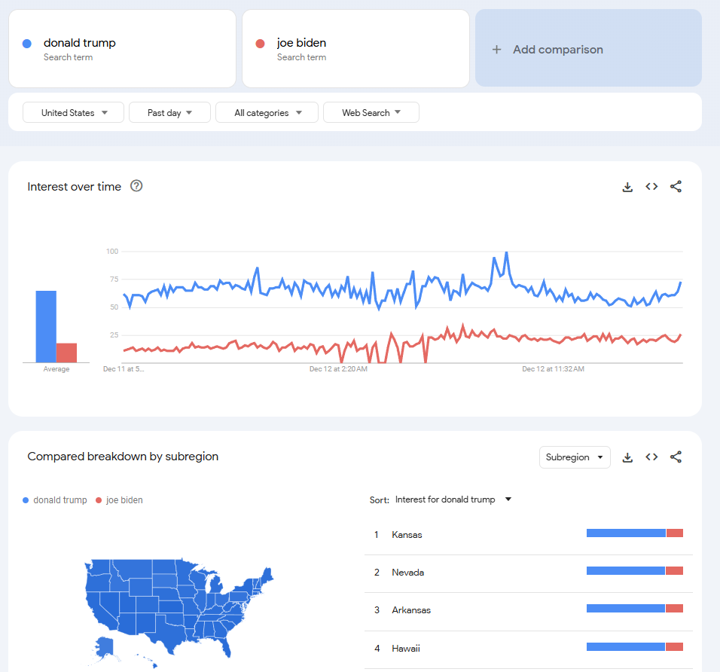
Our Inspiration
Google Trends enables users to discover trends of interest, utilizing queries from:
Google Search
YouTube
Provides geographic and temporal insights for any subject, except:
Duplicates from the same user
Non-meaningful queries
Google Trends https://trends.google.com/trends/explore?date=now%201-d&geo=US&q=donald%20trump,joe%20biden&hl=en

Slide 13
Our Approach

Slide 14
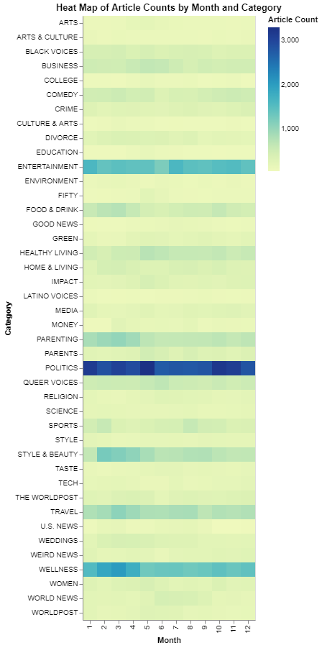
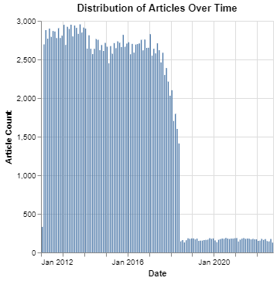
Distributions

Slide 15
Project Workflow
Downloaded from Kaggle, containing >200k articles.
Tokenized articles, extracting Names, Locations, Nationalities, Organizations, Verbs, Adjectives, and N-grams.
Plugged-in processed dataset into the interactive tool.
Dataset Collection
Data Processing
Entity Extraction
Dataframe Formatting
Plugin Data with Tool
Removed duplicates, categories, non-text, and missing data, with 90k articles still remaining.
Convert dataset to a database (.db) for optimized fetching.

Slide 16
Dataset Processing
Excluded articles with missing or empty values.
Used the ftfy library to resolve text encoding issues.
Removed Most Categories Except (24):
Black Voices
Business
College
Crime
Entertainment
Environment
Good News
Green
Impact
Latino Voices
Media
Money
Politics
Queer Voices
Religion
Science
Style
Tech
The World Post
U.S. News
Weird News
Women
World News
WorldPost

Slide 17

Dataset Processing
Excluded articles with missing or empty values.
Used the ftfy library to resolve text encoding issues.
210k reduced to 91k articles
Removed Most Categories Except (24):
Black Voices
Business
College
Crime
Entertainment
Environment
Good News
Green
Impact
Latino Voices
Media
Money
Politics
Queer Voices
Religion
Science
Style
Tech
The World Post
U.S. News
Weird News
Women
World News
WorldPost

Slide 18
Project Workflow
Downloaded from Kaggle, containing >200k articles.
Tokenized articles, extracting Names, Locations, Nationalities, Organizations, Verbs, Adjectives, and N-grams.
Plugged-in processed dataset into the interactive tool.
Dataset Collection
Data Processing
Entity Extraction
Dataframe Formatting
Plugin Data with Tool
Removed duplicates, categories, non-text, and missing data, with 90k articles still remaining.
Convert dataset to a database (.db) for optimized fetching.

Slide 19
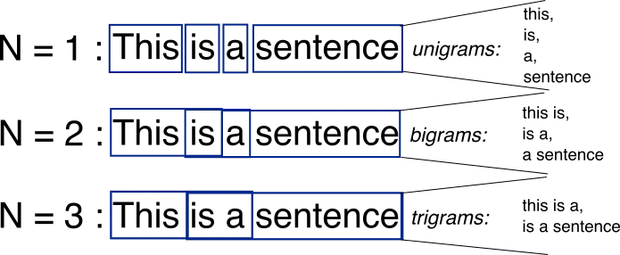
Goals of Entity Extraction
Identifying tokens within news articles (headlines and descriptions), extracting and utilizing:
Names
Locations
Nationalities
Organizations
Verbs
Adjectives
N-grams
N-grams are sets of words (≥1) that help machines decipher word-order and relevancy within language. We are using N-grams (1-3 words) as searchable/analyzable entities for our analysis tool.
Jain, Abhishek. "N-grams in NLP." Medium (Feb 5, 2024) medium.com/@abhishekjainindore24/n-grams-in-nlp-a7c05c1aff12

Slide 20
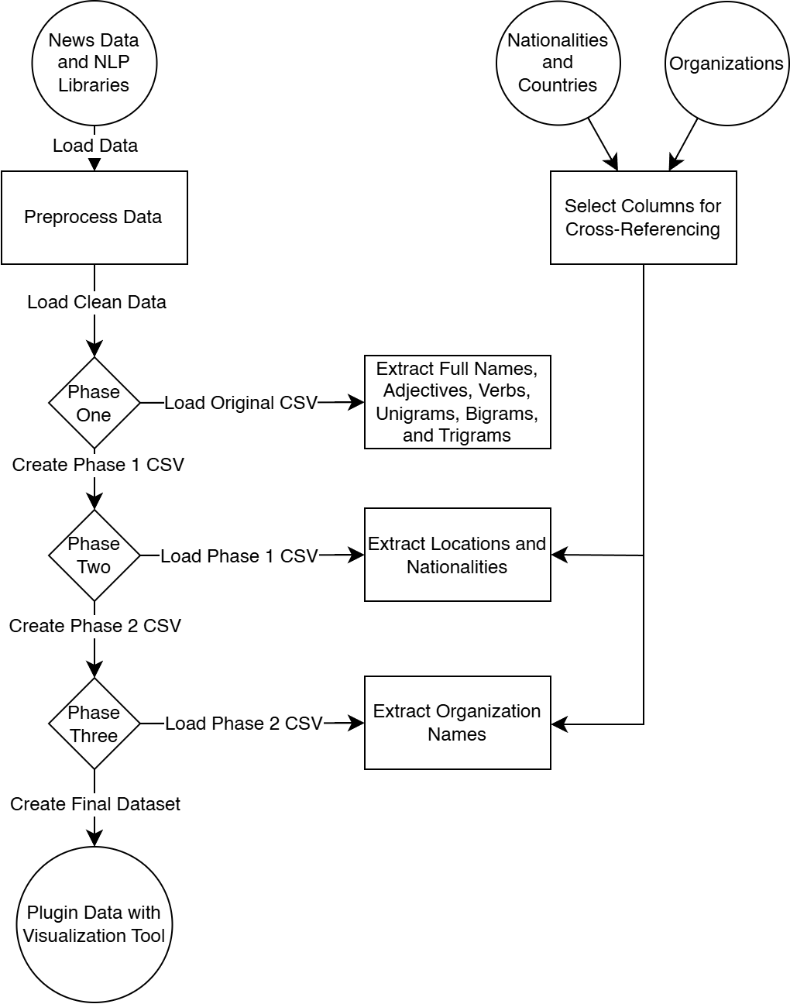
Entity Extraction In Action
Utilized Natural Language Processing (NLP) libraries, spaCy and NLTK pre-trained models, for named entity recognition (NER).
Entity Extraction:
Identifies names, locations, nationalities, and organizations.
Cross-references with external datasets for enhanced accuracy.
Part-of-Speech Tagging:
Classifies words into verbs and adjectives.
Essential for assessing sentiment and emotional contexts.
N-grams:
Finds unigrams, bigrams, trigrams from text.
Crucial for text classification and enhancing search functionalities.

Slide 21
{
"headline": "Over 100 Dogs And Monkeys Were Rescued From Michigan Democrat's Shuttered Company",
"category": "POLITICS",
"short_description": "Shri Thanedar owned a New Jersey lab where the poor animals were used in tests.",
"mentions": {
"nationality": ["Democrat"],
"organizations": ["Shuttered Company"],
"locations": ["Michigan", "New Jersey"],
"full_names": ["Shri Thanedar"],
"unigrams":
["Over", "Dogs", "And", "Monkeys", "Were", "Rescued", "From", "Michigan", "Democrat", "Shuttered", "Company", "Shri", "Thanedar", "owned", "a", "New", "Jersey", "lab", "where", "the", “poor”, "animals", "were", "used", "in", "tests"],
"bigrams":
["Dogs And", "And Monkeys", "Monkeys Were", "Were Rescued", "Rescued From", "From Michigan", "Michigan Democrat", "Shuttered Company", "Company Shri", "Shri Thanedar", "Thanedar owned", "owned a", "a New", "New Jersey", "Jersey lab", "lab where", "where the", “the poor”, "poor animals", "animals were", "were used", "used in", "in tests"],
"trigrams":
["Dogs And Monkeys", "And Monkeys Were", "Monkeys Were Rescued", "Were Rescued From", "Rescued From Michigan", "From Michigan Democrat", "Shuttered Company Shri", "Company Shri Thanedar", "Shri Thanedar owned", "Thanedar owned a", "owned a New", "a New Jersey", "New Jersey lab", "Jersey lab where", "lab where the", "where the poor", "the poor animals", "poor animals were", "animals were used", "were used in", "used in tests"],
"adjectives": ["poor"],
"verbs": ["Rescued", "owned", "used"]
}

Slide 22
{
"headline": "Over 100 Dogs And Monkeys Were Rescued From Michigan Democrat's Shuttered Company",
"category": "POLITICS",
"short_description": "Shri Thanedar owned a New Jersey lab where the poor animals were used in tests.",
"mentions": {
"nationality": ["Democrat"],
"organizations": ["Shuttered Company"],
"locations": ["Michigan", "New Jersey"],
"full_names": ["Shri Thanedar"],
"unigrams":
["Over", "Dogs", "And", "Monkeys", "Were", "Rescued", "From", "Michigan", "Democrat", "Shuttered", "Company", "Shri", "Thanedar", "owned", "a", "New", "Jersey", "lab", "where", "the", “poor”, "animals", "were", "used", "in", "tests"],
"bigrams":
["Dogs And", "And Monkeys", "Monkeys Were", "Were Rescued", "Rescued From", "From Michigan", "Michigan Democrat", "Shuttered Company", "Company Shri", "Shri Thanedar", "Thanedar owned", "owned a", "a New", "New Jersey", "Jersey lab", "lab where", "where the", “the poor”, "poor animals", "animals were", "were used", "used in", "in tests"],
"trigrams":
["Dogs And Monkeys", "And Monkeys Were", "Monkeys Were Rescued", "Were Rescued From", "Rescued From Michigan", "From Michigan Democrat", "Shuttered Company Shri", "Company Shri Thanedar", "Shri Thanedar owned", "Thanedar owned a", "owned a New", "a New Jersey", "New Jersey lab", "Jersey lab where", "lab where the", "where the poor", "the poor animals", "poor animals were", "animals were used", "were used in", "used in tests"],
"adjectives": ["poor"],
"verbs": ["Rescued", "owned", "used"]
}

Slide 23
Project Workflow
Downloaded from Kaggle, containing >200k articles.
Tokenized articles, extracting Names, Locations, Nationalities, Organizations, Verbs, Adjectives, and N-grams.
Plugged-in processed dataset into the interactive tool.
Dataset Collection
Data Processing
Entity Extraction
Dataframe Formatting
Plugin Data with Tool
Removed duplicates, categories, non-text, and missing data, with 90k articles still remaining.
Convert JSON dataset to a database (.db) for optimized fetching.

Slide 24
Database
1. articles
Parent entity
id: Unique identifier for each article (INTEGER, Primary Key).
link: URL link to the article (TEXT).
headline: The headline of the article (TEXT).
category: The category of the article (TEXT).
short_description: A brief description of the article (TEXT).
authors: The author(s) of the article (TEXT).
date: The publication date of the article (TEXT).
2. mentions
One-to-many relationship with ‘articles’
id: Unique identifier for each mention (INTEGER, Primary Key).
article_id: Reference to the associated article (INTEGER).
mention_type: The type of mention (TEXT).
mention_text: The text of the mention (TEXT).
3. ngrams
One-to-many relationship with ‘articles’
id: Unique identifier for each n-gram (INTEGER, Primary Key).
article_id: Reference to the associated article (INTEGER).
ngram_type: Type of the n-gram (e.g., bigram, trigram) (TEXT).
ngram_text: The text of the n-gram (TEXT).
4. words
One-to-many relationship with ‘articles’
id: Unique identifier for each word (INTEGER, Primary Key).
article_id: Reference to the associated article (INTEGER).
word_type: Type of the word (e.g., noun, verb) (TEXT).
word_text: The text of the word (TEXT).
5. sqlite_sequence
Used internally for managing auto-increment fields
name: Name of the table using auto-increment (TEXT).
seq: The current sequence number for auto-increment (INTEGER).

Slide 25
Implementation

Slide 26
Project Workflow
Downloaded from Kaggle, containing >200k articles.
Tokenized articles, extracting Names, Locations, Nationalities, Organizations, Verbs, Adjectives, and N-grams.
Plugged-in processed dataset into the interactive tool.
Dataset Collection
Data Processing
Entity Extraction
Dataframe Formatting
Plugin Data with Tool
Removed duplicates, categories, non-text, and missing data, with 90k articles still remaining.
Convert dataset to a database (.db) for optimized fetching.

Slide 27
Trends Over Time

Slide 28
Co-Occurrences

Slide 29
Sentiment

Slide 30
Demonstration

Slide 31
Potential Improvements

Slide 32
Outcome

Slide 33
Insights
Our approach to entity-level sentiment analysis is relatively unique.
 | Most Other Projects | Our Project
Main Approach | Classification techniques | Visualization techniques
Tools | Deep learning algorithms with neural networks | Data clusters and co-occurrences
Data Processing | Did not alter dataset | Processed dataset further
Overall Design | Event-level analysis | Entity-level analysis

Slide 34
Challenges
Exploring Textual Data
Technical Obstacles
Limited Feedback
Visualizing text-heavy data, with broad themes, is an intentionally difficult undertaking.
We have taken on this design challenge in an attempt to discover new solutions and insights.
Lack of experience, and thus proficiency with handling large datasets caused some setbacks.
This has been a major learning opportunity for everyone involved.
Without being able to receive a consistent stream of feedback and iterate upon our design, we may oversee certain key issues within our interaction techniques.

Slide 35
Possible Impact
Media News
News outlets may frame the same topics differently based on their political leanings.
Example: Some outlets might call an issue "immigration" while others refer to it as "border security."
Project Insight: Sentiment and entity analysis can show how different news categories reflect these biases.
Public Relations(PR) Strategies
By analyzing how companies or individuals are portrayed in the news, PR teams can improve their messaging.
Example: Sentiment trends for companies like "Tesla" can help PR teams respond to public concerns.
Project Insight: Your analysis of sentiment over time helps organizations adapt their strategies effectively.

Slide 36
Contd…
3. News Trends
News trends reveal how public interests shift over time.
Example: Coverage of "climate change" increased significantly after the 2015 Paris Agreement.
Project Insight: Your timeline analysis tracks changes in focus, such as increasing attention to environmental issues.
4. Cross-Domain Applications
Media Sociology: Analyzing how news is framed helps us understand public opinions.
Public Policy: Governments can use sentiment analysis to see how people react to policies.
Misinformation Analysis: Identifying patterns in misleading information helps combat false narratives.

Slide 37
Conclusion
Understanding trends in news media helps us see how topics change over time, how people feel about them, and how biases appear. This project shows how data can help us make better decisions in areas like media, public relations, and policy. By improving this work, we can better understand the world around us and share information more effectively.
Through this project, we analyzed trends in news media over a decade, identifying shifts in public sentiment, topic frequency, and co-occurrence patterns. By applying Natural Language Processing (NLP) and visualization techniques, we uncovered meaningful insights into how news is framed and its impact on public discourse.
This work lays the foundation for further research, including integrating more datasets, enhancing models, and expanding the analysis to include global news trends.

Slide 38
Citations
Misra, Rishabh. "News Category Dataset." arXiv preprint arXiv:2209.11429 (2022). https://arxiv.org/pdf/2209.11429
Download Link: https://www.kaggle.com/datasets/rmisra/news-category-dataset?resource=download
Misra, Rishabh and Jigyasa Grover. "Sculpting Data for ML: The first act of Machine Learning." ISBN 9798585463570 (2021). https://rishabhmisra.github.io/Sculpting_Data_for_ML.pdf
Misra, Rishabh, “Publications.” GitHub Pages, (2024). https://rishabhmisra.github.io/publications/
Sultanum, N., & Setlur, V. “Beyond the visuals: Elevating text as a first-class citizen in dashboard design.” Tableau (2024, October 16). https://www.tableau.com/blog/beyond-visuals-elevating-text-first-class-citizen-dashboard-design
Jain, Abhishek. "N-grams in NLP." Medium (Feb 5, 2024) medium.com/@abhishekjainindore24/n-grams-in-nlp-a7c05c1aff12

